Slide 1


5G Millimeter Wave – Beamforming Challenges and Techniques
Course: ECE 655
Sai Anurag Neelisetty (20911061)
Krishna Kanth Mutta (20919166)

Slide 2
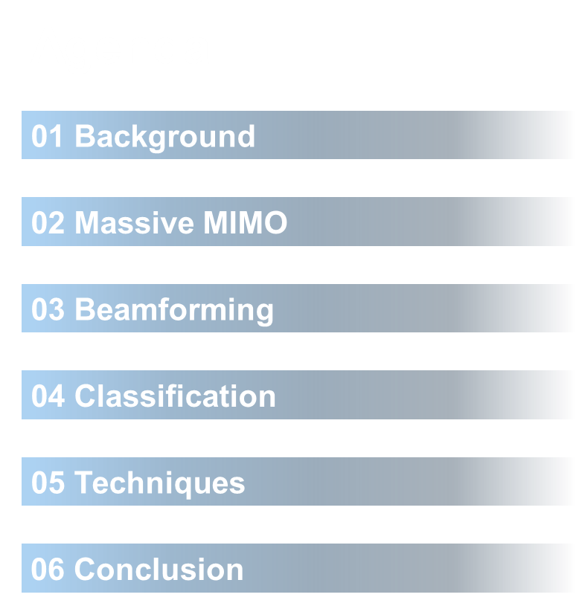

Slide 3
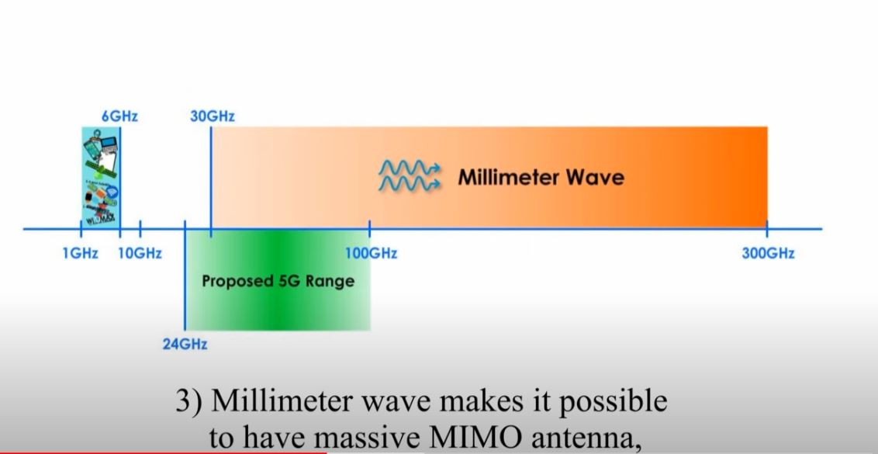
BACKGROUND
MMWave:
High frequency band: 30 – 300 GHz
Pros:
High Bandwidth
Faster data transmission speeds
Lesser n/w latency
Cons:
Coverage,Range limitations
High Propagation loss
Easily Obstructed
Image Source
Current Spectrum Utilization: 1-6 GHz
5G proposes: sub-6 GHz + 24 -100 GHz

Slide 4
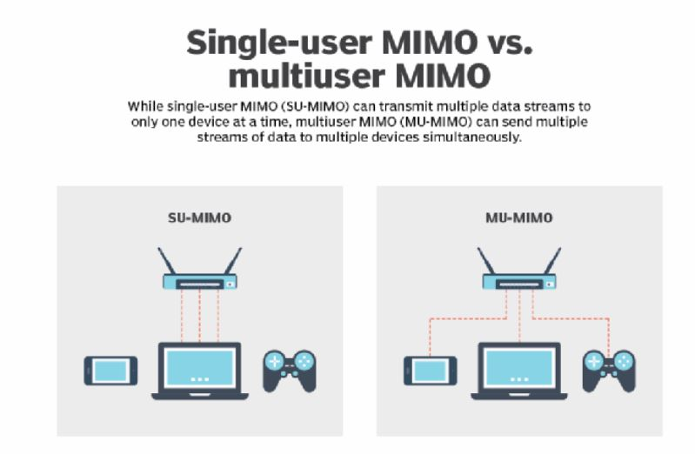
MIMO
Single User - MIMO: Allows single device to communicate multiple data streams with the Router.
Multiple User - MIMO: Allows multiple devices to communicate multiple data streams simultaneously with the Router.
Pros:
High network capacities
More Coverage
Enables stronger signals
High throughput
Better User Experience
Image Source

Slide 5
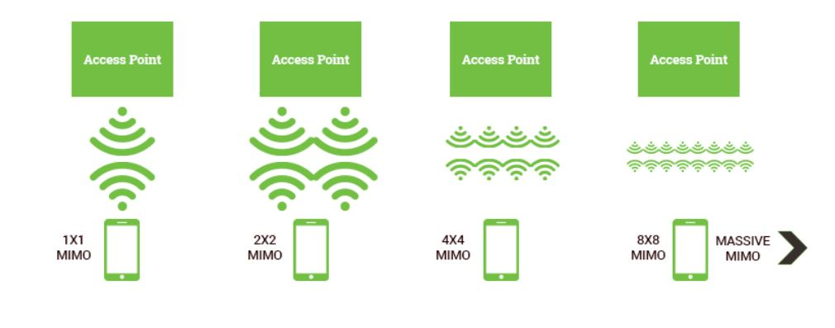
Massive MIMO
Image Source
Multiple Path Wireless Communication

Slide 6
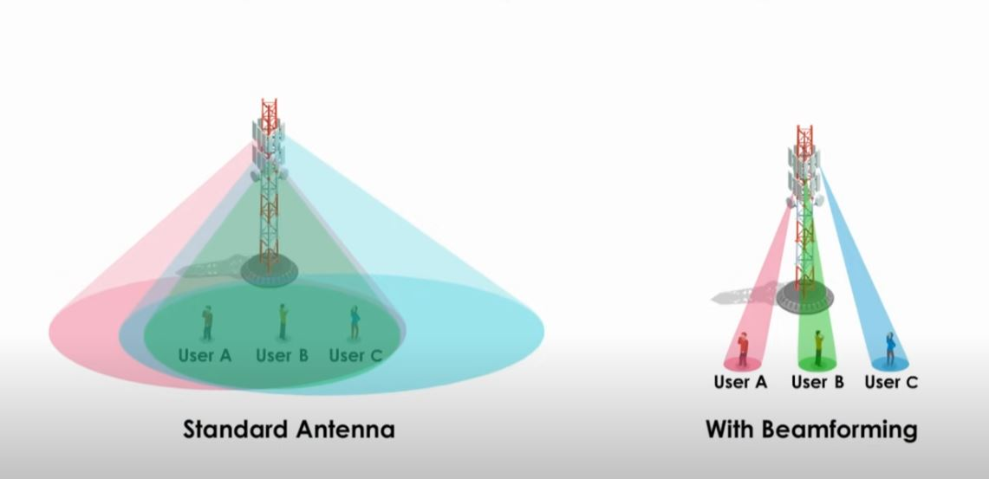
BEAMFORMING
Focus a wireless signal towards a specific user in a chosen direction with the help of antenna arrays.
Pros:
Enhance the precision of 5G connections
Improves Throughput
Mitigates mm-wave propagation loss
Reduces Interference
Improves SNR
Challenges:
Complex design
Increased cost
Health issues
Image Source

Slide 7
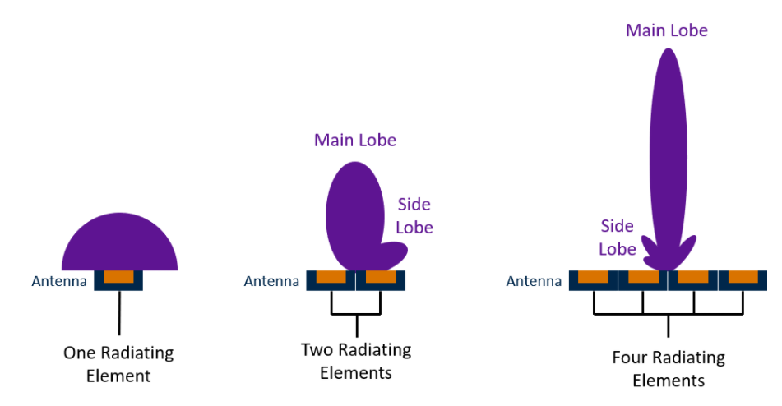
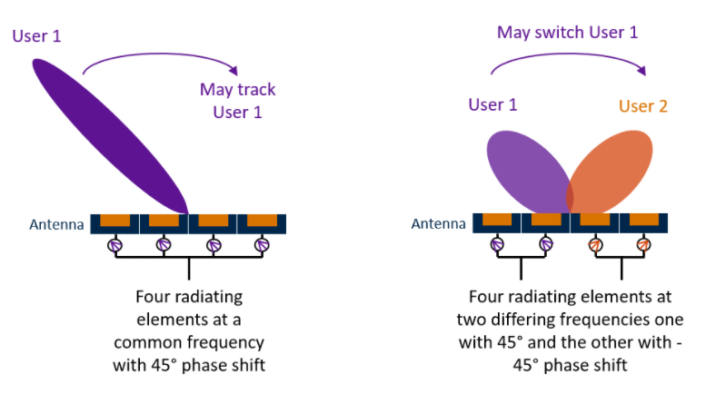
BEAMFORMING
Image Source

Slide 8
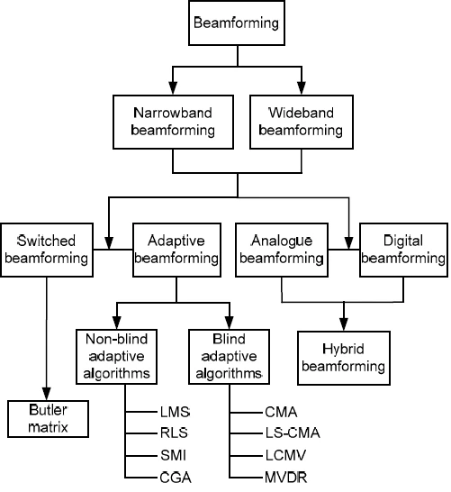
CLASSIFICATION
Beamforming classification is based on Physical characteristics, Algorithms, Signal processing, and Bandwidth
Bandwidth - Narrow-band and Wide-band
Physical Characteristics - Switched and Adaptive
Signal Processing - Analog, Digital, and Hybrid
Image Source

Slide 9
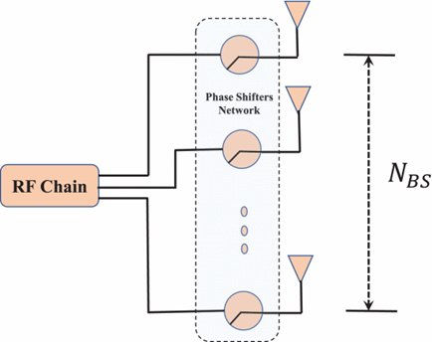
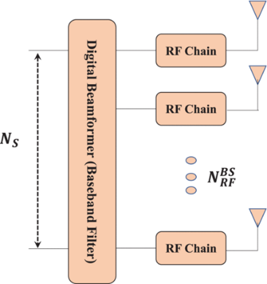
ANALOG, DIGITAL, HYBRID BEAMFORMING
Analog Beamforming
Pros: Inexpensive phase shifters, Consume low power
Cons: Less flexible, Low Performance
Digital Beamforming
Pros: Cost Effective & Flexible, Accurate & high resolution
Cons: Difficult to implement, Consume high power

Slide 10
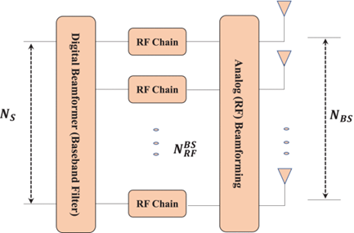
ANALOG, DIGITAL, HYBRID BEAMFORMING
Hybrid Beamforming
Pros:
Can be used at mm-wave frequencies
No Complex signal routing
Dynamic change in # of beams with no change in hardware
No full RF chain per element
Cons:
Complex antenna design
Flexibility compared to Digital beamforming is less
Digital beamforming is not suitable for mm-wave massive MIMO systems because of RF chains that follow each antenna array element in the system.
Hybrid beamforming is a cost-effective alternative, which requires small number of RF chains and thus can significantly reduce hardware cost and power consumption.
Source

Slide 11
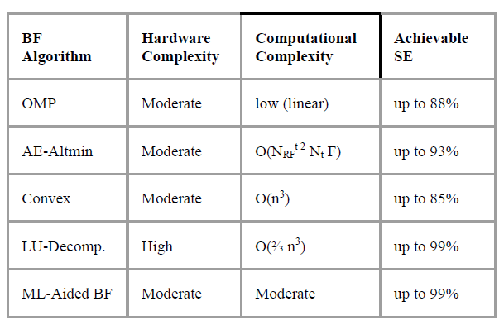
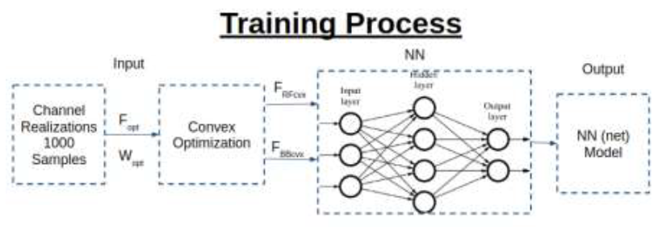
HOW DEEP LEARNING ENHANCES SE IN HYBRID BEAMFORMING?
Hybrid Beamforming for Multiuser MIMO mmWave Systems Using Artificial Neural Networks
Comparison of BF Techniques
Training Process

Slide 12
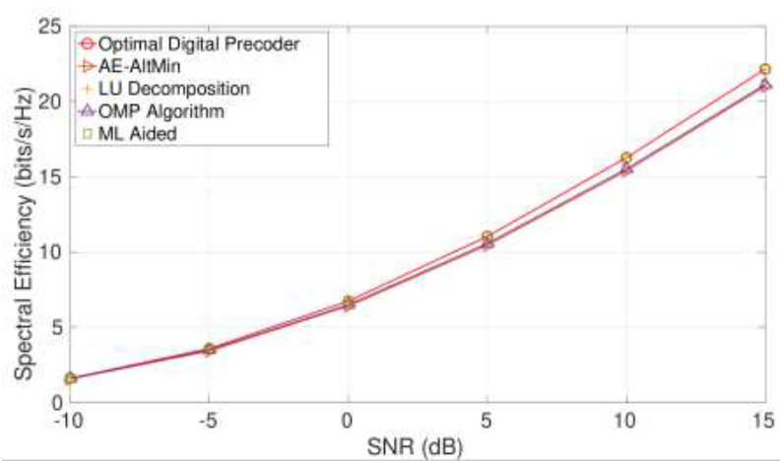
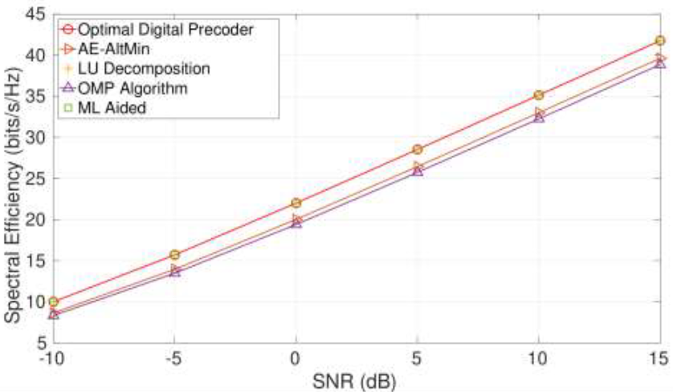
Simulation Results:
Figure indicates the Achievable spectral efficiency in (bits/sec/Hz) for 16X4 MIMO cellular system for each of the 10 users.
Figure indicates the Achievable spectral efficiency in (bits/sec/Hz) for 46X16 MIMO cellular system for each of the 10 users.
Source

Slide 13
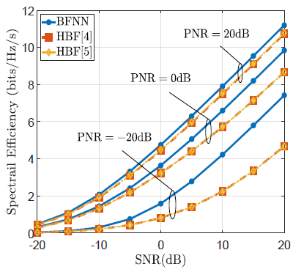
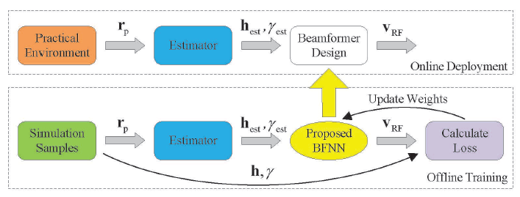
Beamforming Design for Large-Scale Antenna
Arrays Using Deep Learning
Figure indicates the Two-stage DL-based HBF design approach: offline training and online deployment.
Figure indicates the Simulation results of SE v.s. SNR for different BF algorithms with different PNRs.
Source

Slide 14
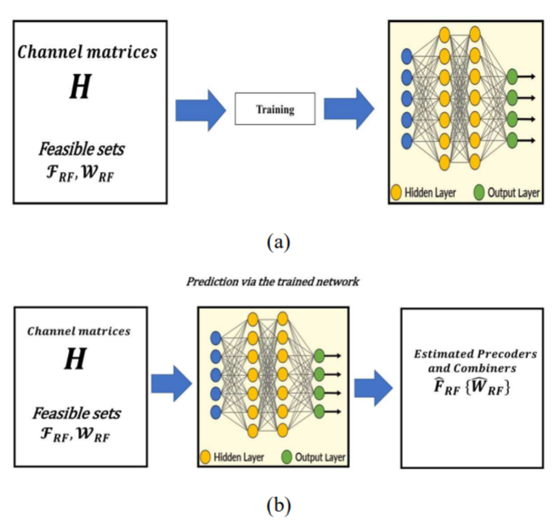
Deep learning-based hybrid beamforming design for joint optimization of the precoder and combiner in massive MIMO mmWave communication systems.
Low complexity hybrid precoding & Design of mmWave MIMO system.
MATLAB for simulating massive MIMO system.
Proposed technique has been compared with legacy optimization-based hybrid beamforming techniques and performs better.
The block diagram of (a) the training stage , (b) the prediction stage
Reference

Slide 15
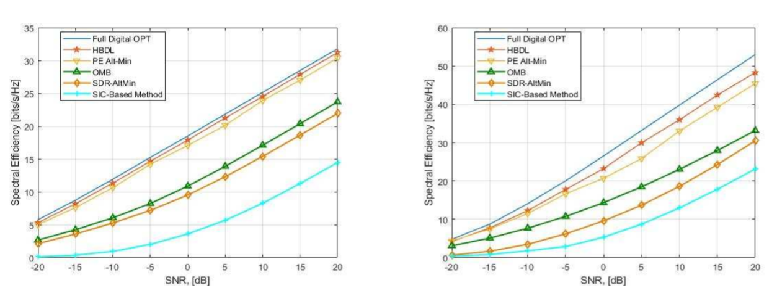
Simulation Results:
Figures indicate the effect of increasing the number of data streams (Ns) and RF chains equal to 2 and 4 on the spectral efficiency.
The simulation result in Figures are obtained by assuming that the number of antenna array elements at the transmitter (Nt) and the receiver (Nr) are fixed and equal to 36 elements.

Slide 16
Submissions:
Final report of the Literature Review
Presentation Slides
Video Presentation

Slide 17
Thank You

